Slide 1
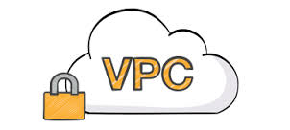
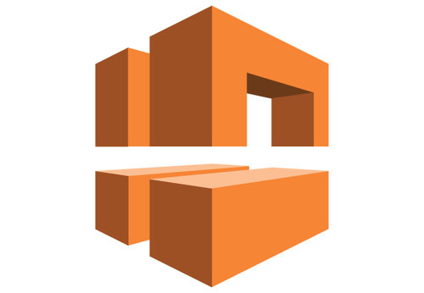
VPC
Presented By:
Sandeep Rawat

Slide 2
Agenda
Introduction to VPC
VPC Components
VPC Architecture Scenario
Hands On Activity

Slide 3
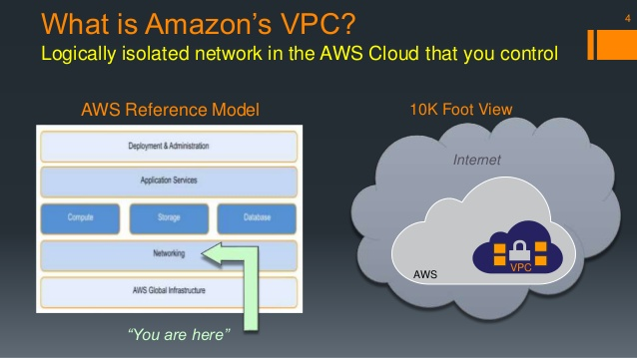
VPC - Explained
Notes:
Give some history related to Classic EC2 when all instances were used to be publically open and the challenges faced during that time
- Open for public access
- A lot of effort required to make components talk to each other
- Earlier there was lot of difficulty due to chaning private ip

Slide 4
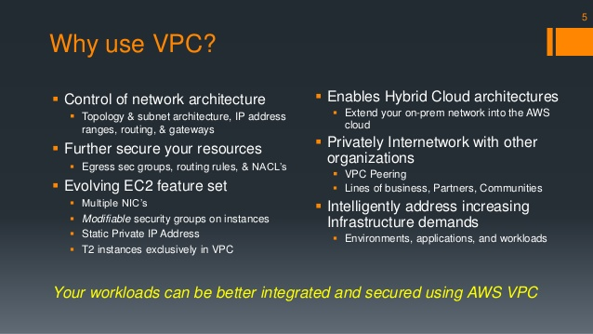
Why VPC

Slide 5
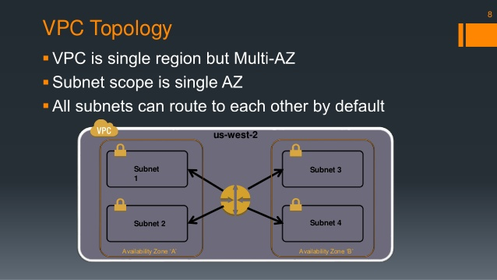
Why Topology

Slide 6
VPC Fundamentals
Amazon VPC is an isolated network within the AWS cloud that you define
In your VPC you can
Create multiple public and/or private subnets
Launch resources with your own private IP address into a subnet
Define VPC security groups, Access Control Lists (ACL), Subnet Route Tables and Routes

Slide 7
VPC Fundamentals - Drivers
Drivers for the use of a VPC architecture are
The network isolation from other accounts
The extra network security available in VPC
As an extension of the corporate network – access through a VPN
Static private IP address don’t change on instance stop/start

Slide 8
VPC Fundamentals - Subnets
If a subnet has a route to an AWS Internet Gateway it is called a public subnet
If there is no route from a subnet to an AWS Internet Gateway it is a private subnet. If an instance in an private subnet wants to access the internet it needs to use a NAT in a public subnet
Each subnet must reside entirely within one Availability Zone
Instances in a VPC communicate based on Route Table, VPC Security Groups and Access Control Lists

Slide 9
Security Groups, ACLs, Routes
VPC Security Groups control both inbound and outbound access between instances (EC2 Security Groups can only define inbound rules). A firewall at the instance level

Slide 10
Security Groups, ACLs, Routes
VPC Access Control Lists (ACLs) control access between subnets – firewall at the subnet level, an extra level of security over VPC Security Groups

Slide 11
Security Groups, ACLs, Routes
Subnet Route Table specifies subnet IP routing

Slide 12
VPC Architecture Scenarios
AWS VPC documentation has four architecture scenarios, these are the options available in the AWS management console in the VPC Wizard:
VPC with a Public Subnet Only
VPC with Public and Private Subnets
VPC with Public and Private Subnets and Hardware VPN Access
VPC with a Private Subnet Only and Hardware VPN Access

Slide 13
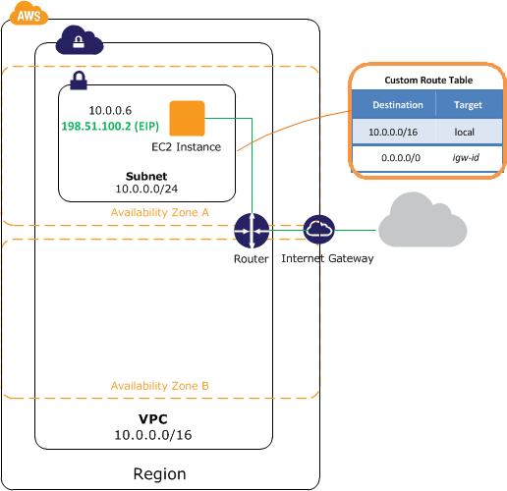
VPC with a Public Subnet Only

Slide 14
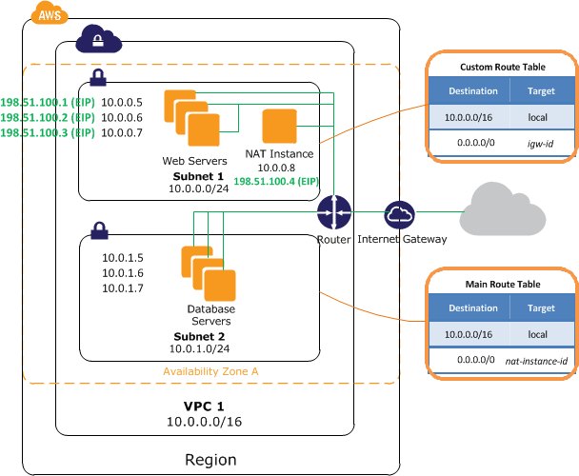
VPC with Public and Private Subnets

Slide 15
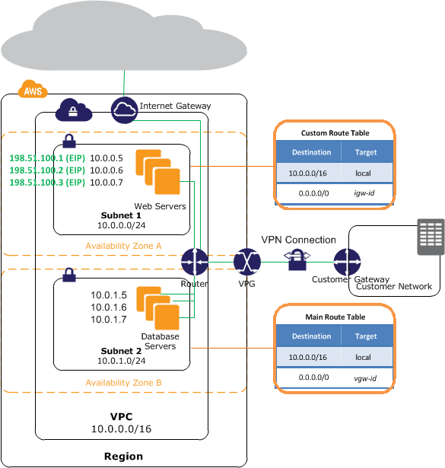
VPC with Public and Private Subnets and Hardware VPN Access

Slide 16
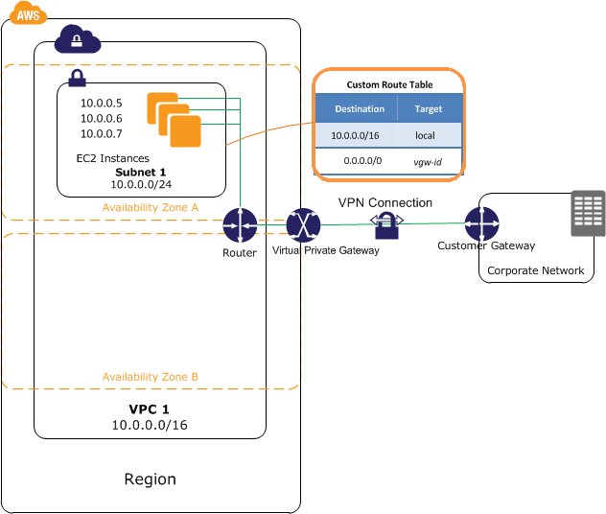
VPC with a Private Subnet Only and Hardware VPN Access

Slide 17
Amazon VPC Architecture – AWS Products
Products currently available in Amazon VPC are
Amazon EC2
Amazon RDS¹ – can deploy RDS to a private subnet
Auto Scaling
Elastic Load Balancing² – in a VPC, ELB is also available internally, unlike public cloud EC2, where ELB is only available as internet facing
Amazon EMR
Elastic Beanstalk³
ElasticCache

Slide 18
Let's do it...
3 layers: web, app & db
Only web layer be exposed for public access
App layer will only accept requests from web layer
Db layer will only accept requests from App layer
Instances in these layers can talk to internet
Notes:
- Show the introduction of subnet, having
- web layer
- app layer
- db layer
- Introduce security group
- show various security group's that we will be going to create.
Tasks:
wget https://raw.githubusercontent.com/OpsTree/AWSTraining/master/setup.sh
sudo puppet apply /etc/puppet/modules/dbsetup.pp
sudo puppet apply /etc/puppet/modules/tomcatsetup.pp
sudo puppet apply /etc/puppet/modules/webserversetup.pp
sudo puppet apply /etc/puppet/modules/webserverstaticsetup.pp
Upload webapp to tomcat server with tomcat user
http://example.com/Employee/
http://static.example.com/

Slide 19
Conclusion
VPC Designing should be well thought
Proper CIDR planing
As much isolation as possible
Take VPC limits into consideration
Security Group vs ACL
Naming conventions
Notes:
http://harish11g.blogspot.in/2014/01/Amazon-Virtual-Private-Cloud-VPC-best-practices-tips-for-architecture-migration.html
- Woolworth story of ELB issues
- Woolworth story of CIDR
- Importance of naming convetions

